Slide 1
ENGI 301 Who Said it: Taylor or Shakespeare? A Trivia Game Project Proposal
Mon, Sept 25th
Valentina Ortega

Slide 2
Background Information
As a huge Taylor Swift and trivia fan, I wanted to create a fun game that would test one’s ability to think under pressure! Pitch:
“Taylor Swift is a world-famous pop star and Shakespeare is one of the greatest literary minds; in some of Taylor’s newest albums, she has borrowed literature devices and poetic structures similar to those used in many of Shakespeare’s writings. “With 30 seconds on the clock and 20 quotes… will YOU tell the difference?”
No improvements on existing projects
I wanted to take this opportunity to really learn how to create functional python code from scratch
I have not found any projects that have done exactly what I want to do… but there are some from which I can draw inspiration to create my own game
Arcade game: https://www.hackster.io/oscar-soto/engi-301-pokey-clicker-game-1fbcc4
All-in-one morning updates: https://www.hackster.io/irene-kwon/all-in-one-morning-updates-with-pocketbeagle-e50b00#schematics

Slide 3
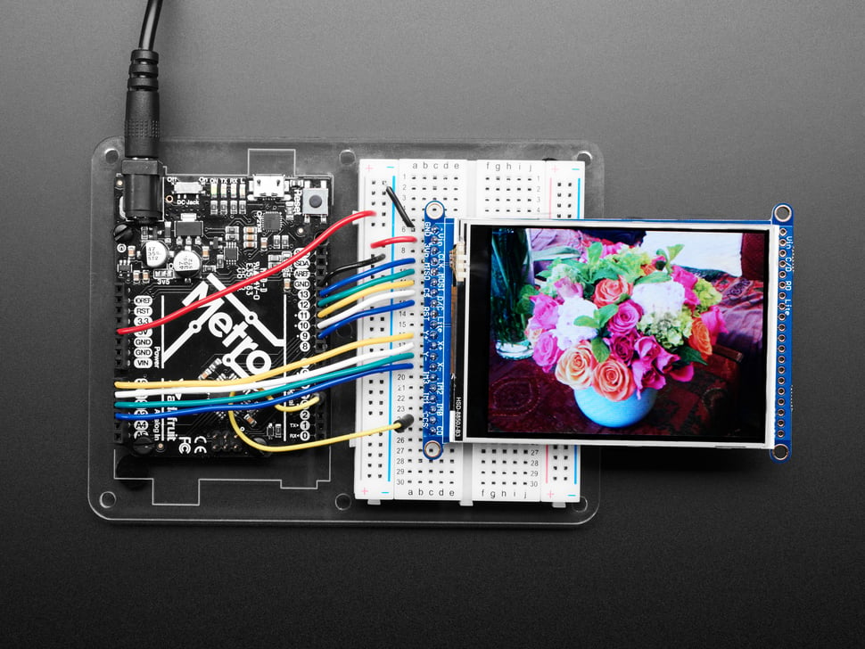
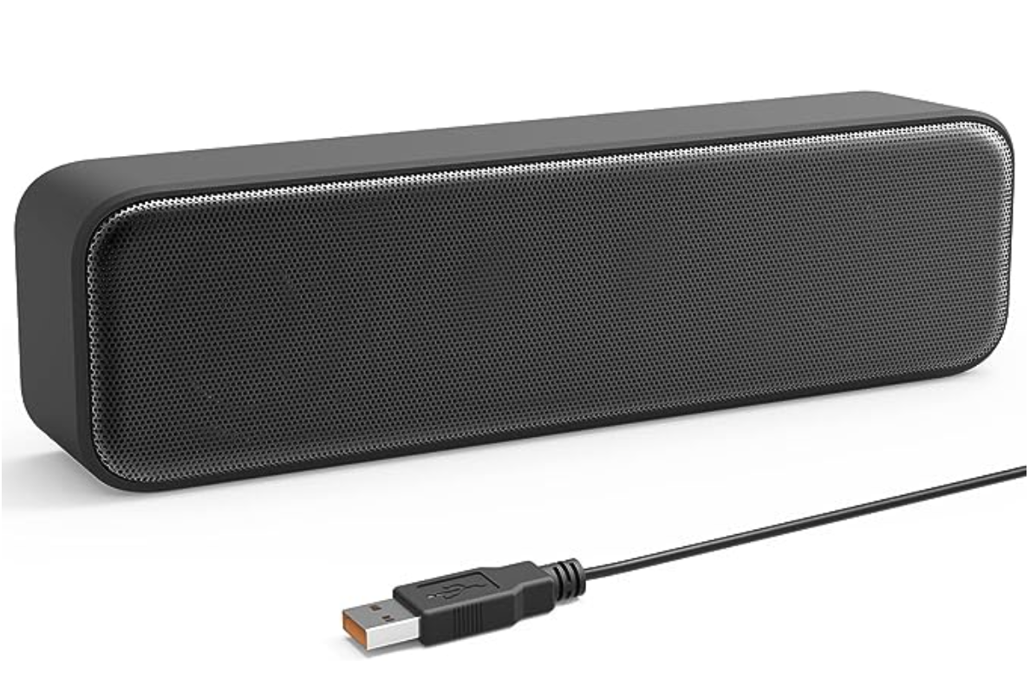
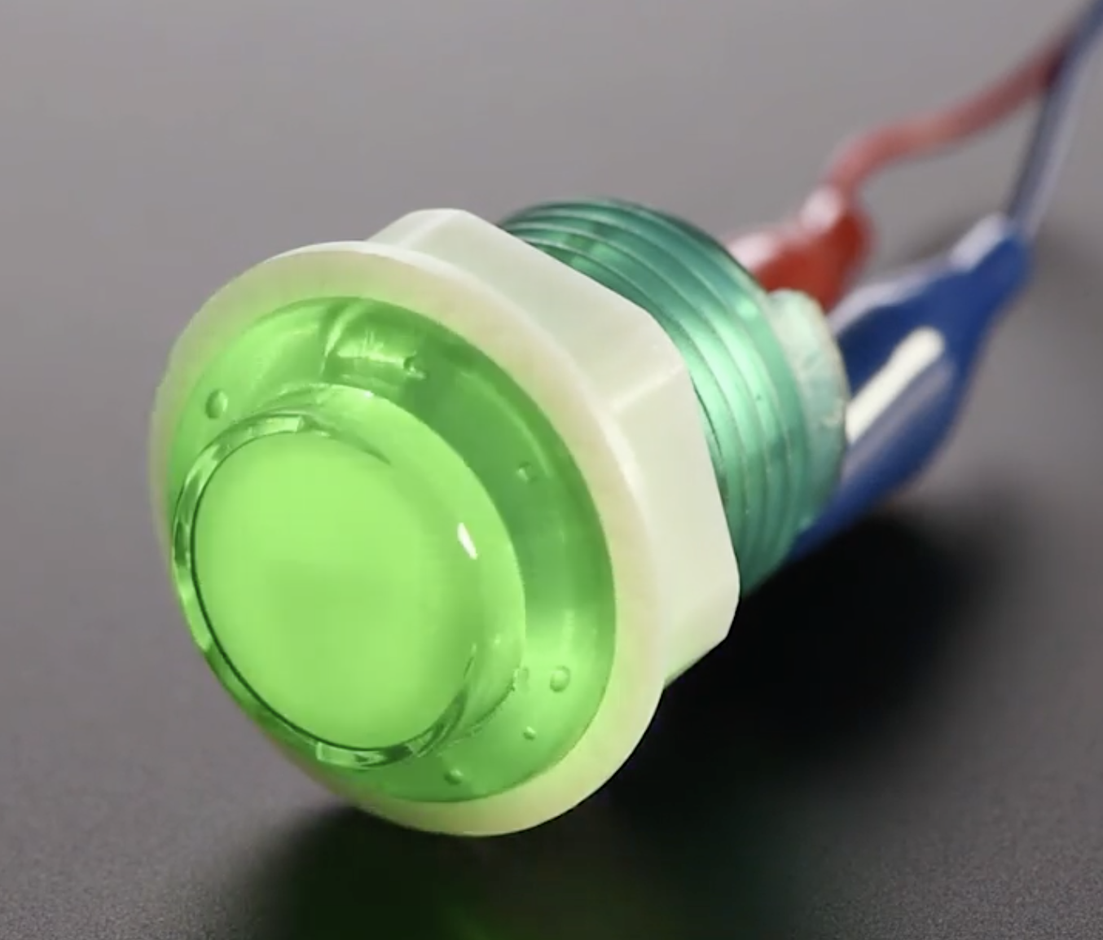
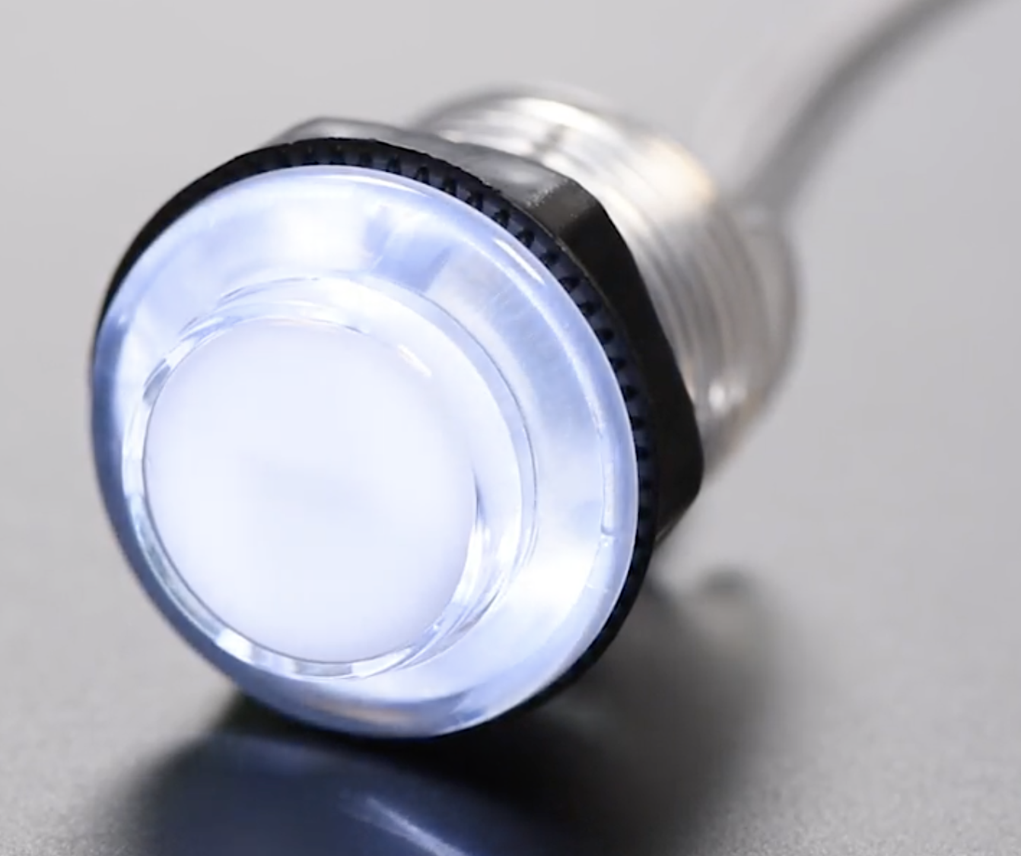
Background Information
No improvements on existing projects
I wanted to take this opportunity to really learn how to create functional python code from scratch
I have not found any projects that have done exactly what I want to do… but there are some from which I can draw inspiration to create my own game
Game theory/LEDs inspo:
Arcade game: https://www.hackster.io/oscar-soto/engi-301-pokey-clicker-game-1fbcc4
Text display inspo:
All-in-one morning updates: https://www.hackster.io/irene-kwon/all-in-one-morning-updates-with-pocketbeagle-e50b00#schematics
“I wish to know the fatal flaw that makes you long to be magnificently cursed”
a) Shakespeare b) Taylor

Slide 4
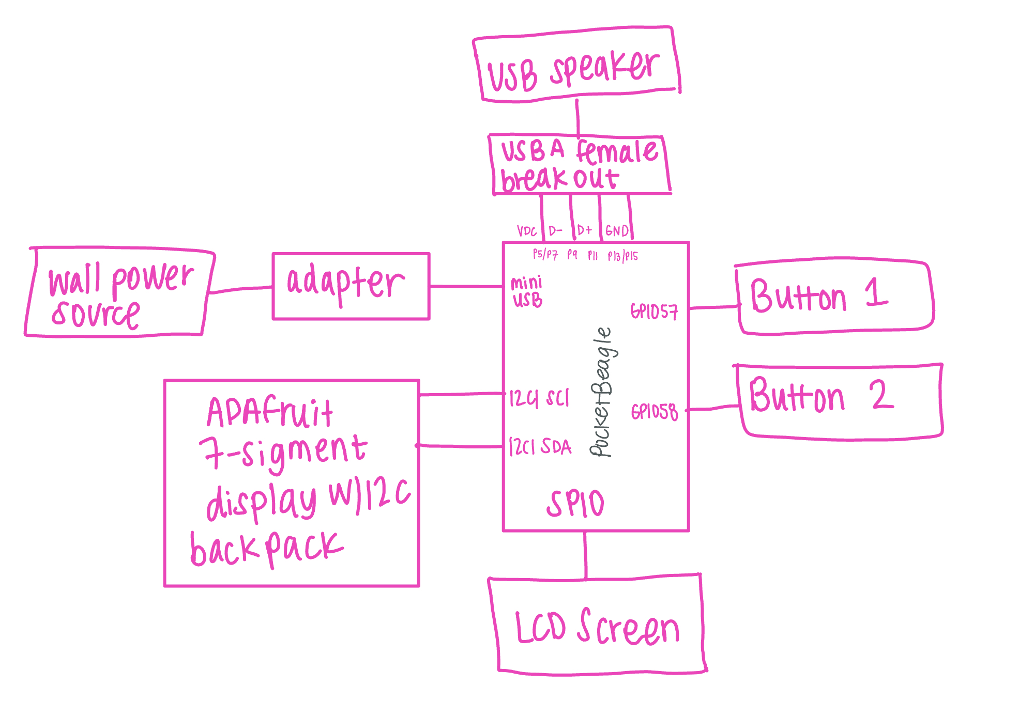
System Block Diagram

Slide 5
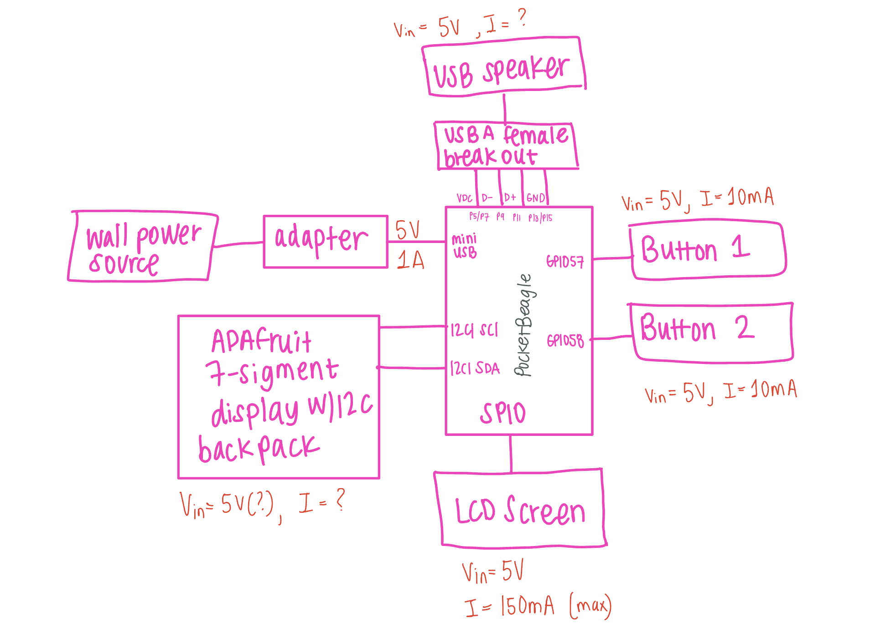
Power Block Diagram

Slide 6
Components / Budget
Component | Need to Buy | Cost
3.2” Color TFT LCD display with MicroSD Card Breakout - ST7735R (display screen) | 1 | $34.95
USB Computer /Laptop Speaker (speaker) | 1 | $15.88
Arcade Button - 30mm Translucent Clear (buttons 1 and 2) | 2 | $5.00
LED Lights | 1 | $17.65
Total |  | $73.48
Notes:
5V usb adapter
We have timer and micro usb breakout in the parts kit
Make LED screen bigger
Keep a dynamic score on screen

Slide 7
Component Selection (Remove slide for submission)
All components must be from either: Amazon, Adafruit, Sparkfun, Digi-Key, or Mouser
Select no more than two (2) components that are not on approved component spreadsheet
See Canvas → Files → assignments → ENGI301_project_01_parts_list.xlsx
All components needed for the project should be listed on Slide 5
All components should have links to the website where they can be purchased
Please trim URLs for links to Amazon
All components together should not cost more than $75
If you have a special request, we can discuss in the project meeting

